Slide 1


You Only Know What U.F.O: Sighting versus Military Bases
Team Red Members
Albert Lee
Courtney Cole
Garret Foley
Matt Mcdowell
Mohamed Ibrahim
Date: July 9, 2024

Slide 2
Introduction
Project Overview: The main goal of this project is to explore the different aspects of UFO sighting in USA including relationship with military base locations, the most common type of UFO sighted, The USA Coast with the most sighting, whether the increase or decreases in the number of UFO being sighting from 2010. Our team try to answer some of the questions that have surround the mystery of UFOs. This Project is part of in KU Bootcamp challenge for data sciences and analysis. It covers both aspects of data engineering and data visualization
Presentation Agenda:
Intro
Data sourcing and & EDA
Research Questions
Summary & Findings
Limitations & Future Research
Conclusion & Questions

Slide 3
Data Sources, Retrieval and the Cleanup Process
https://github.com/gfoley15/you_only_know_what_UFO
Data Source: UFO Sightings: https://nuforc.org/subndx/?id=all
Military Base https://en.wikipedia.org/wiki/List_of_United_States_Air_Force_installations
City Coordinates: https://openweathermap.org/api/geocoding-api#direct_name
Task List:
API Data Retrieval
Data Pre-Processing
Loading to MongoDB
Conclusion
Analysis Summary
Interactivity and Visualization

Slide 4
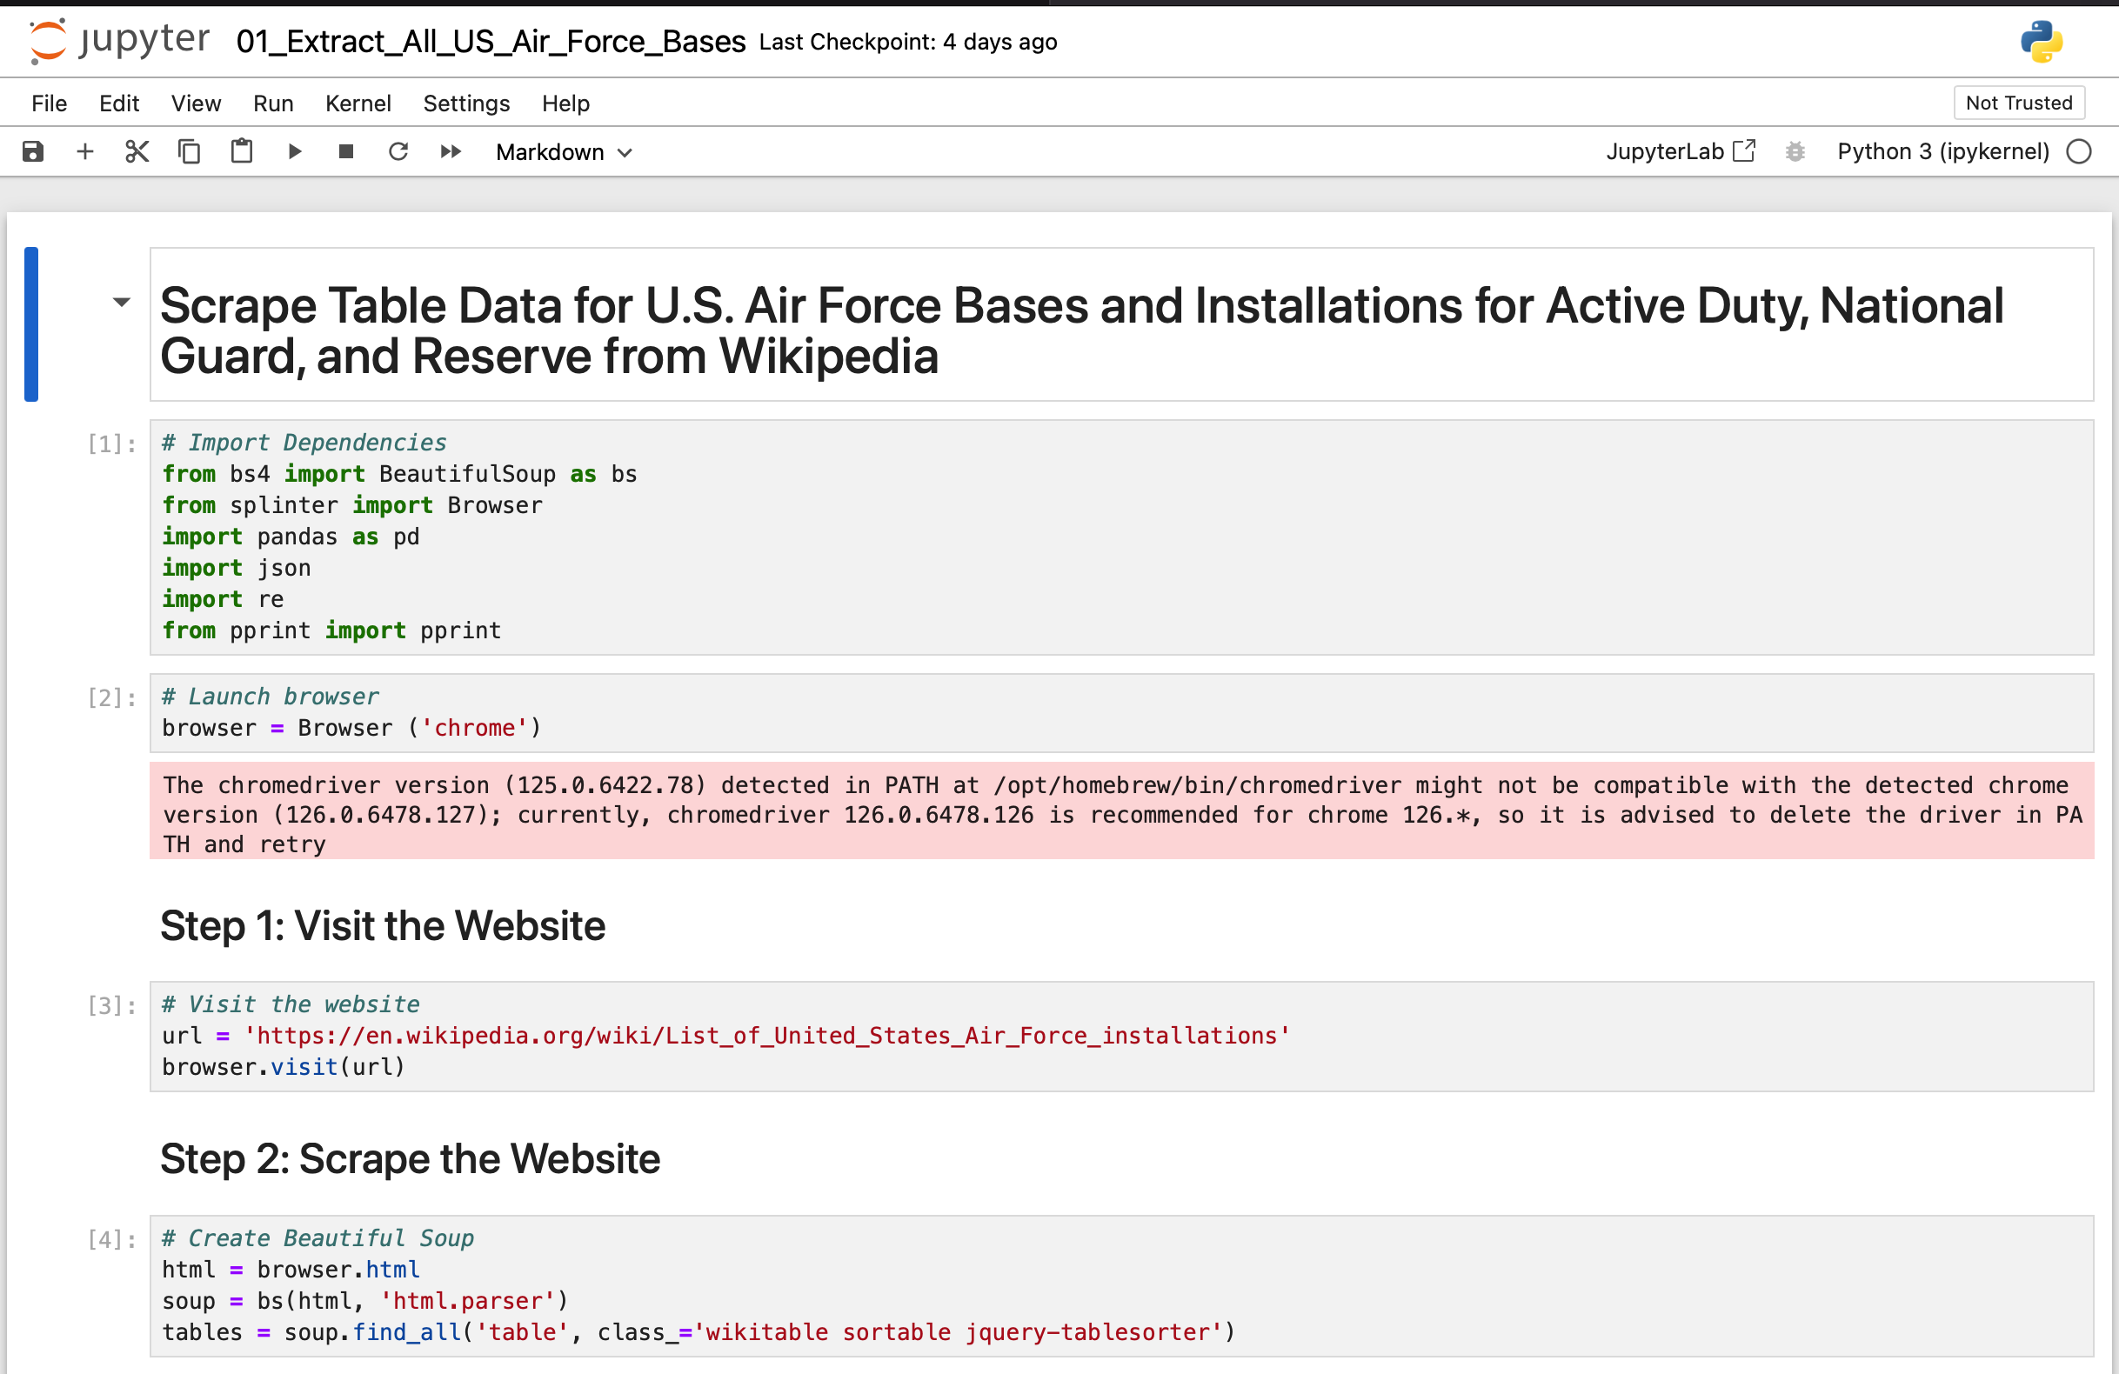
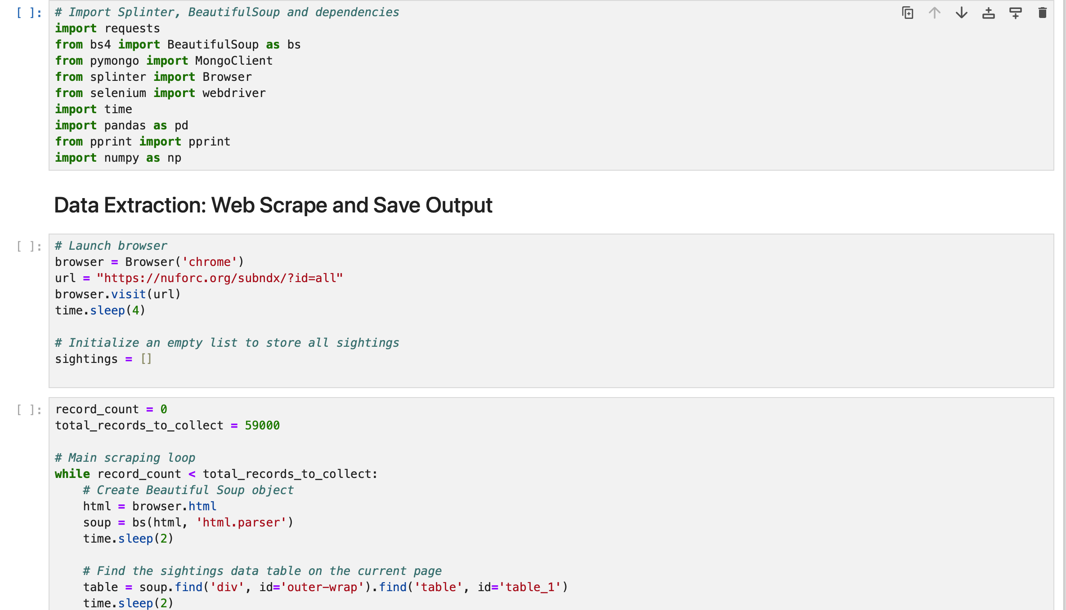
Tools and technologies
Libraries Used:
Python libraries
matplotlib.pyplot, pandas numpy, requests, warnings, time, hvplot, MongoClient, bs4 import BeautifulSoup, from splinter import Browser, from selenium import webdriver
Applications/technologies
Jupyter Notebook, Selenium ChromeDriver, OpenWeather API - GeoAPIfy, Flask, MongoDB (NoSQL), JavaScript ES6, HTML5
JavaScript libraries:
Leaflet.js, Plotly, D3.jsm, New! https://react.dev/learn , New! https://www.chartjs.org/docs/latest/getting-started/
Visualizations:
UFO Sightings Across the U.S.A. - Whiteboard (canva.com)

Slide 5
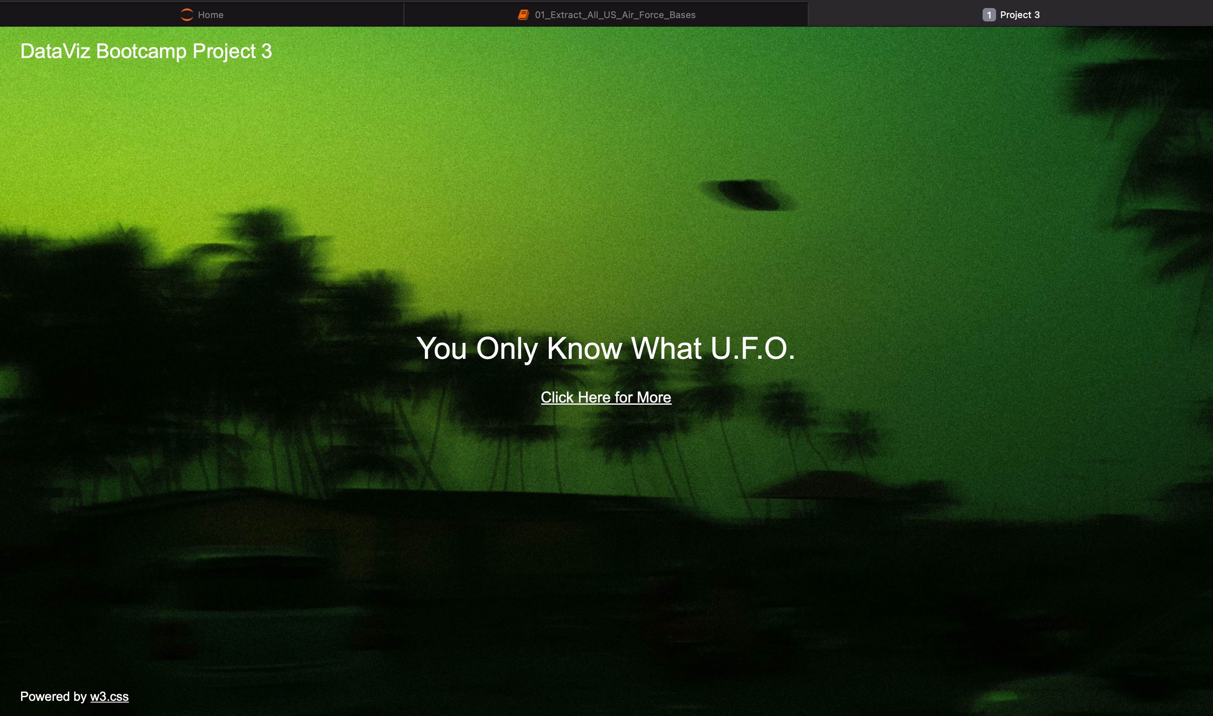
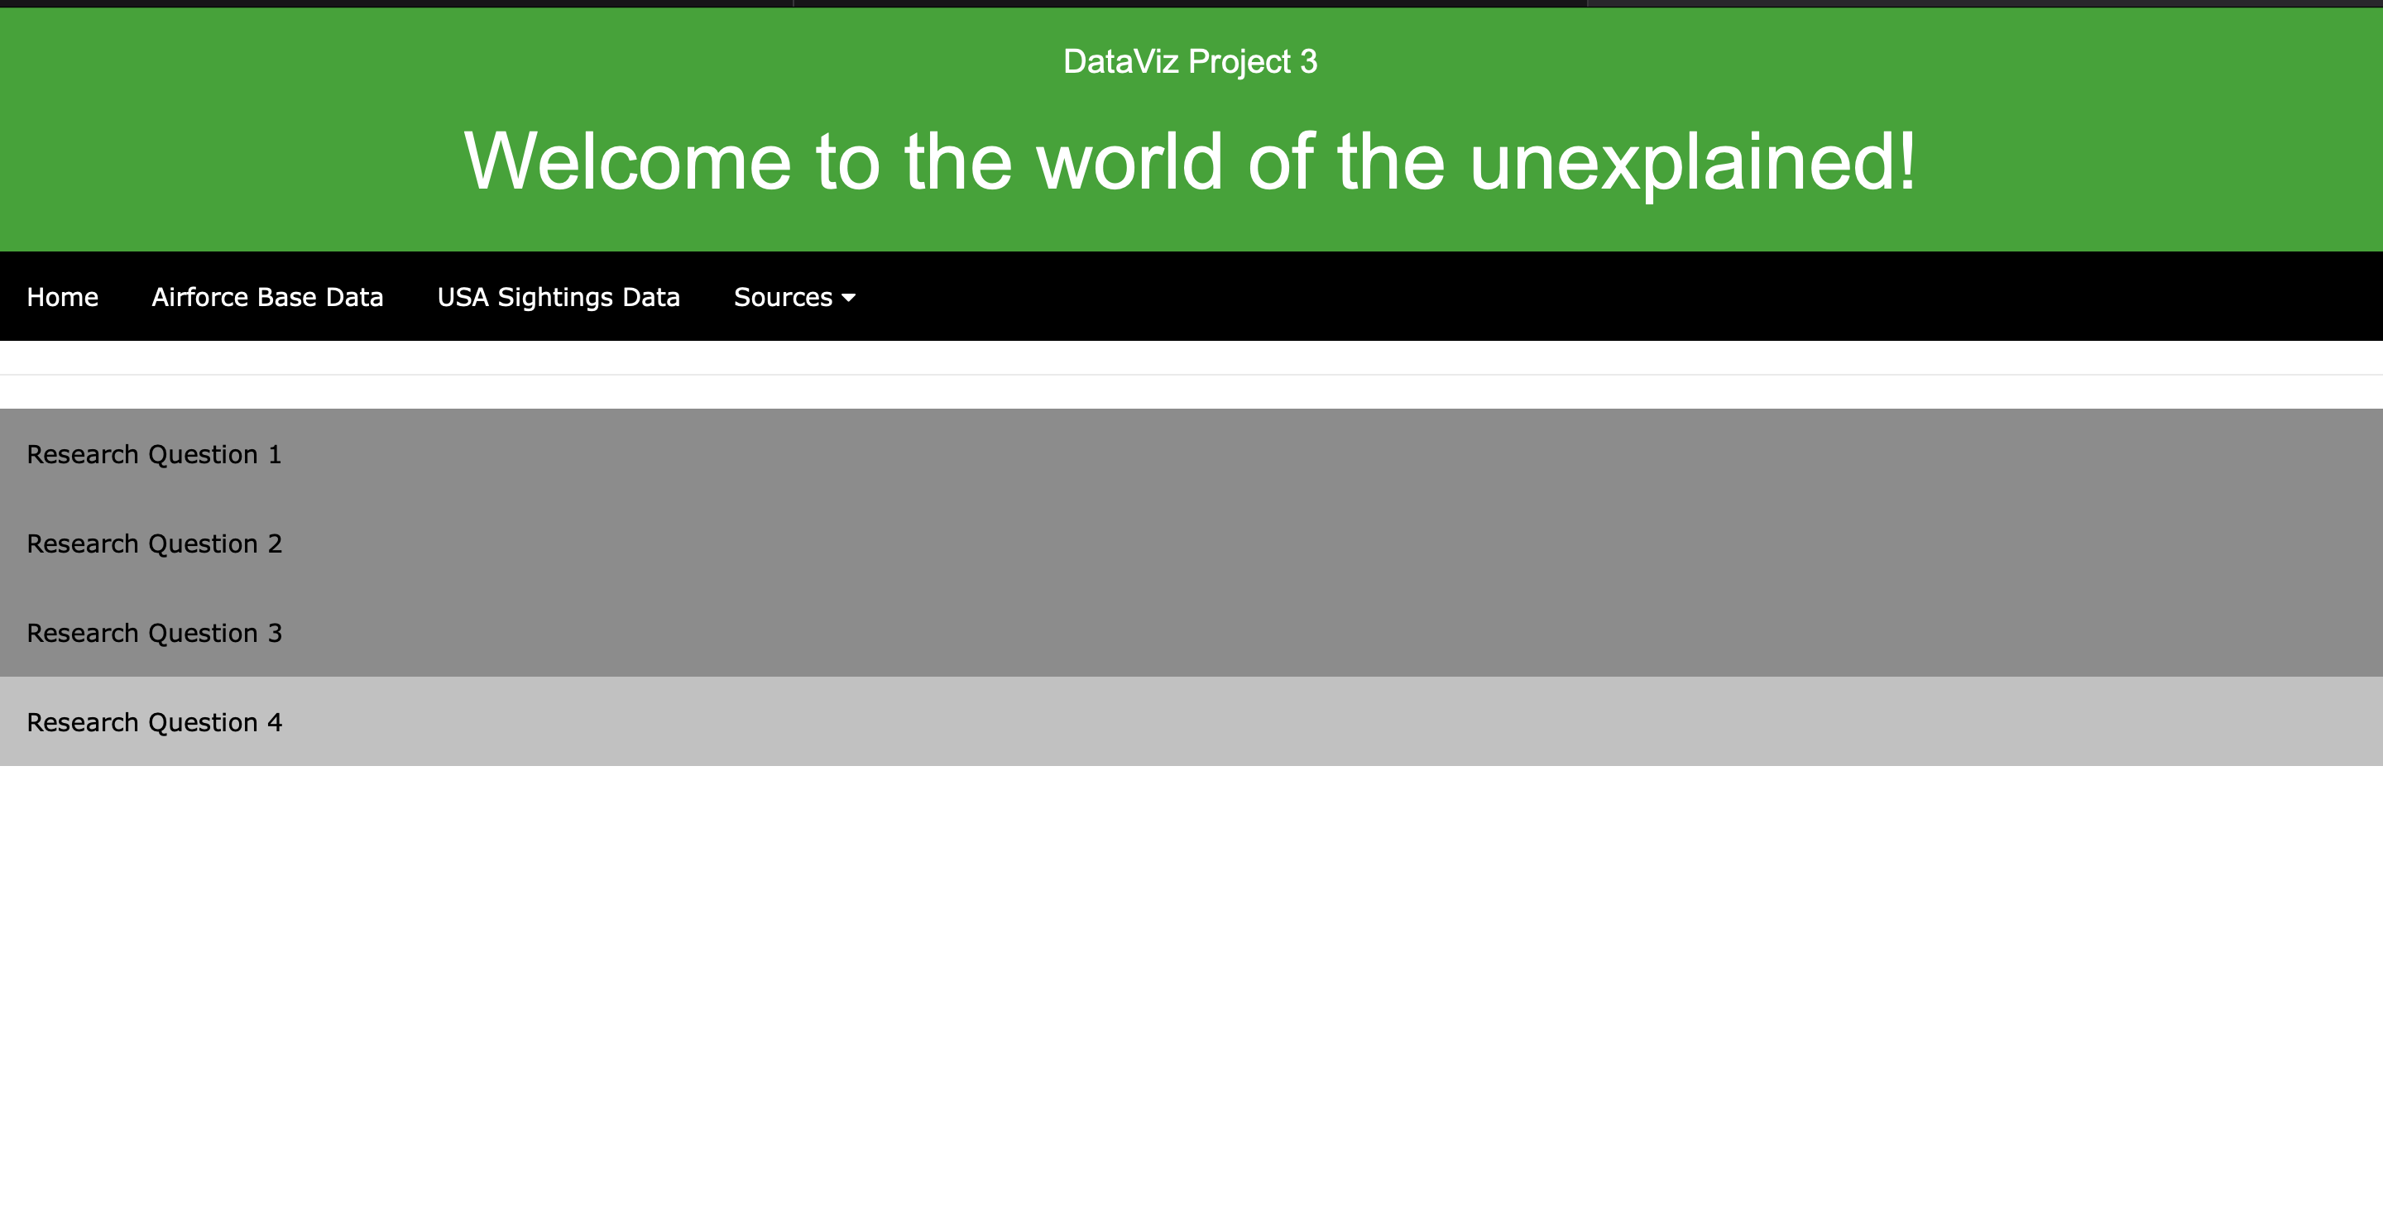
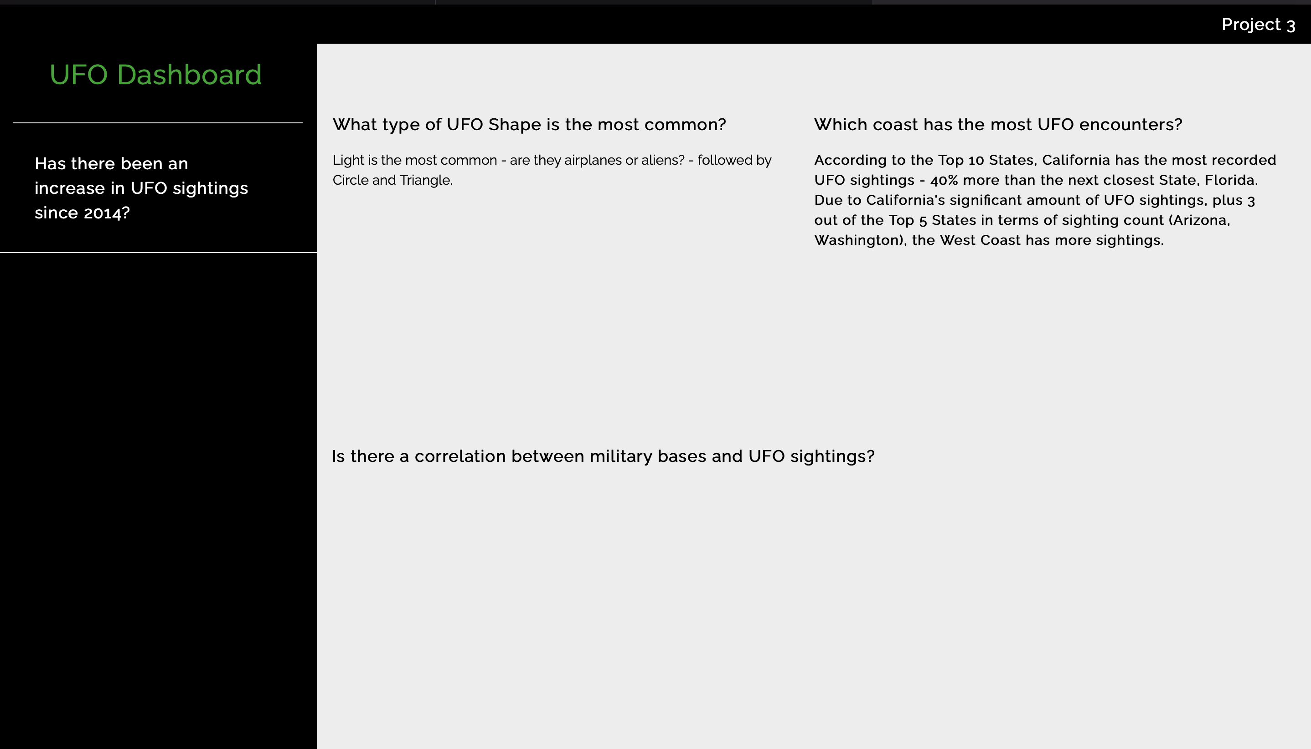
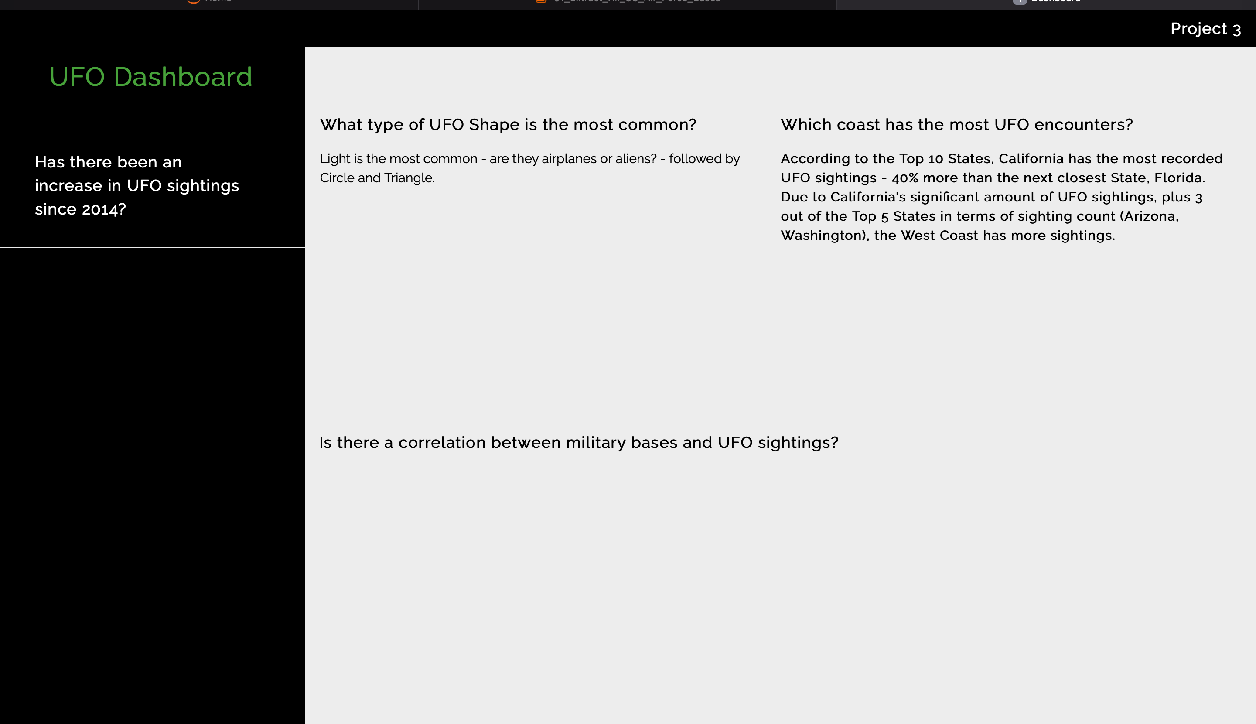
App pages displays

Slide 6
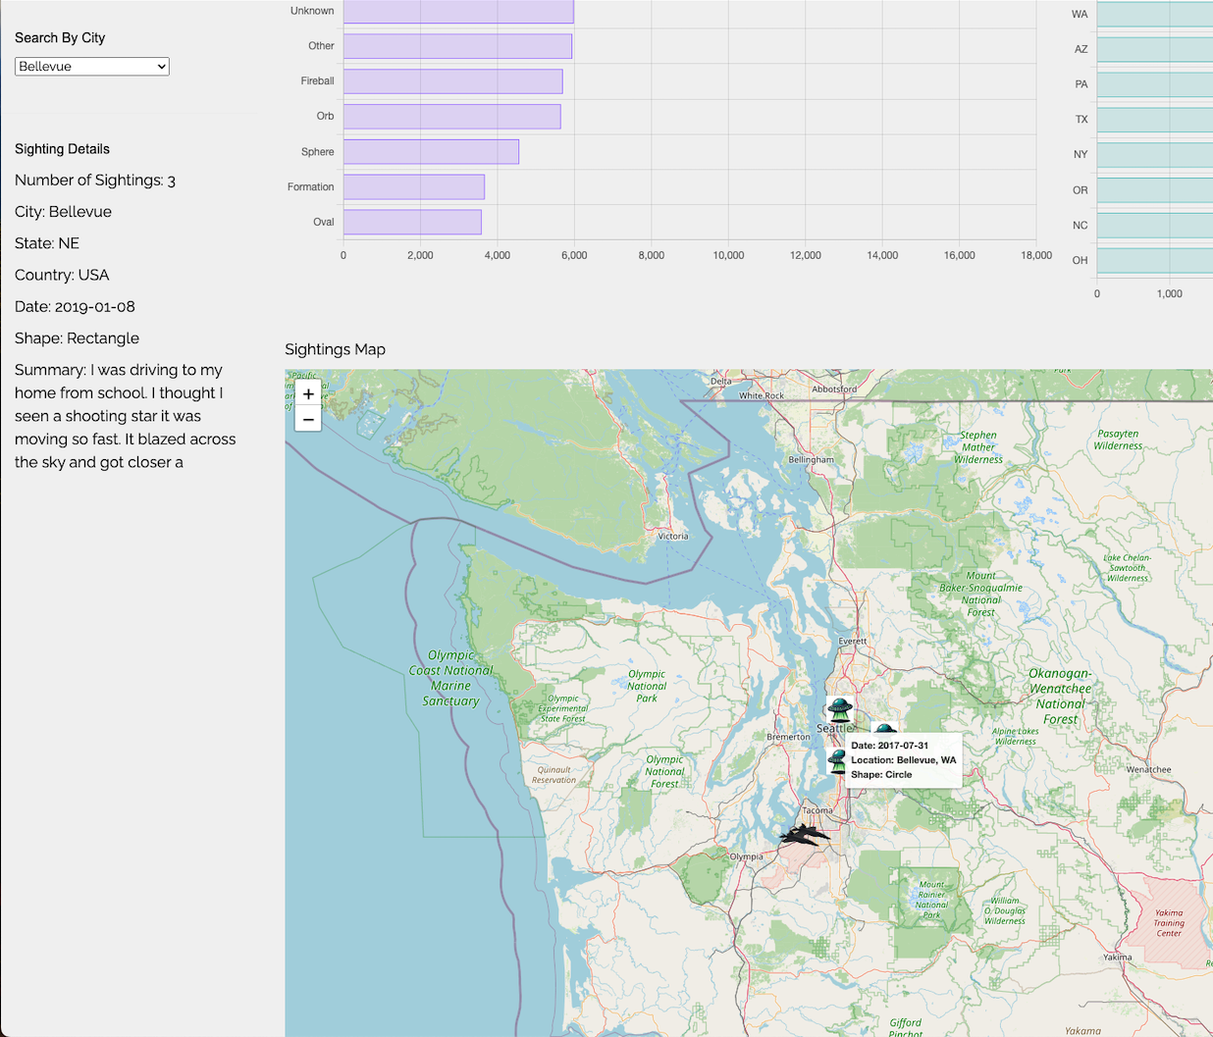
What type of UFO is the most common?

Slide 7
Is there a correlation with military bases and UFO sightings?

Slide 8
Which coast has the most encounters?

Slide 9
Has there been an increase in UFO sightings since 2010?

Slide 10
Summary of Findings

Slide 11
Limitations and Areas for Future Research
Future Research:
Limitations:

Slide 12
Conclusion

